Slide 1
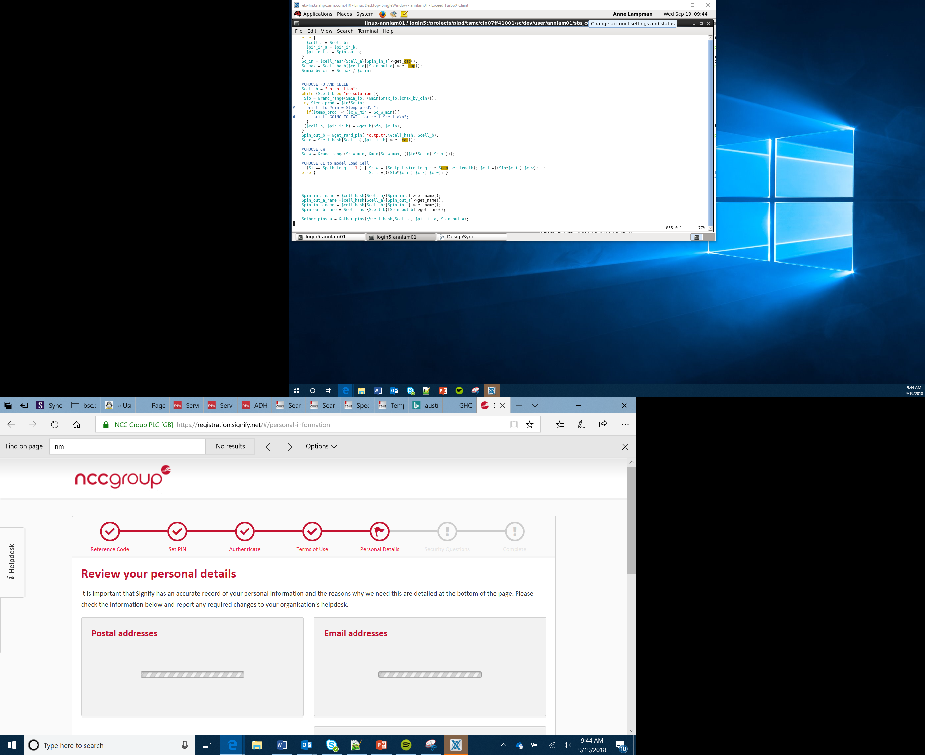

Bit:Bot Race Car Project
Tilt Control and Bluetooth
Lesson 11

Slide 2
Objectives
Be able to send a signal from one micro:bit to another
To be able to receive a signal and process the data
To use the signal to control movement by combining Radio and sensor data
Notes:
Share the objectives with the group
Ensure Learners are aware that Bluetooth is a radio communication protocol
Ensure Learners are aware of what an accelerometer does (link to mobile phones and auto screen rotation)

Slide 3
Radio
The BBC micro:bit has radio hardware that lets you transmit data over Radio wirelessly
Messages are sent on a chosen channel (0-83)
You can set the power of the broadcast which changes the range
With this you can:
program your micro:bit to transmit data
send radio data signals between two or more micro:bit devices
Notes:
Discuss how Bluetooth is not just a method of connecting two devices but is actually used to send data between them, e.g. sound data is transmitted from the phone and received by the Bluetooth headphones or doctors having monitors for heart rate or glucose and then be able to live monitor the data rather than you needing to go into the doctors for tests
Explain we can take advantage of this and use two micro:bits to talk to each other and then make decisions based on the data received

Slide 4
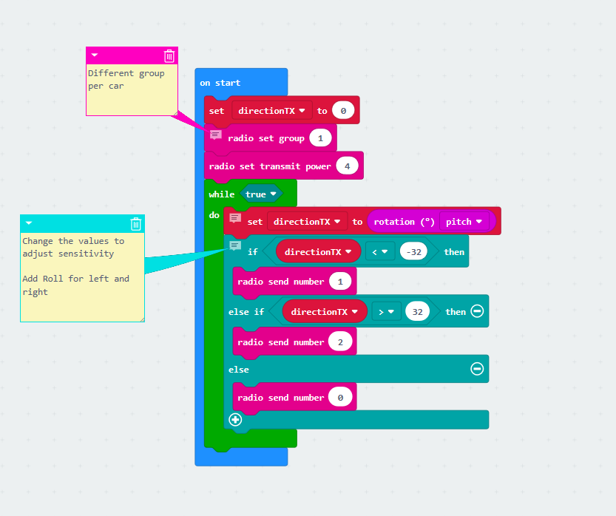
Transmitter
For this project you will need two micro:bits one to act as a transmitter and one to act as the receiver.
Use the code to the right or the ‘Lesson 11 BTTX.hex’ file to create the radio transmitter
Note the use of groups (this will separate different transmitter and receivers)
Note the use of power the bigger the number the greater the range
Notes:
Explain how there are two components
A transmitter to transmit the data and a receiver to use the data
It is important that you discuss radio groups here.
Describe them as channels and that the two devices need to be on the same channel, but each team needs to use a different channel to avoid interference

Slide 5

Notes:
Large version of the example for ease of use

Slide 6
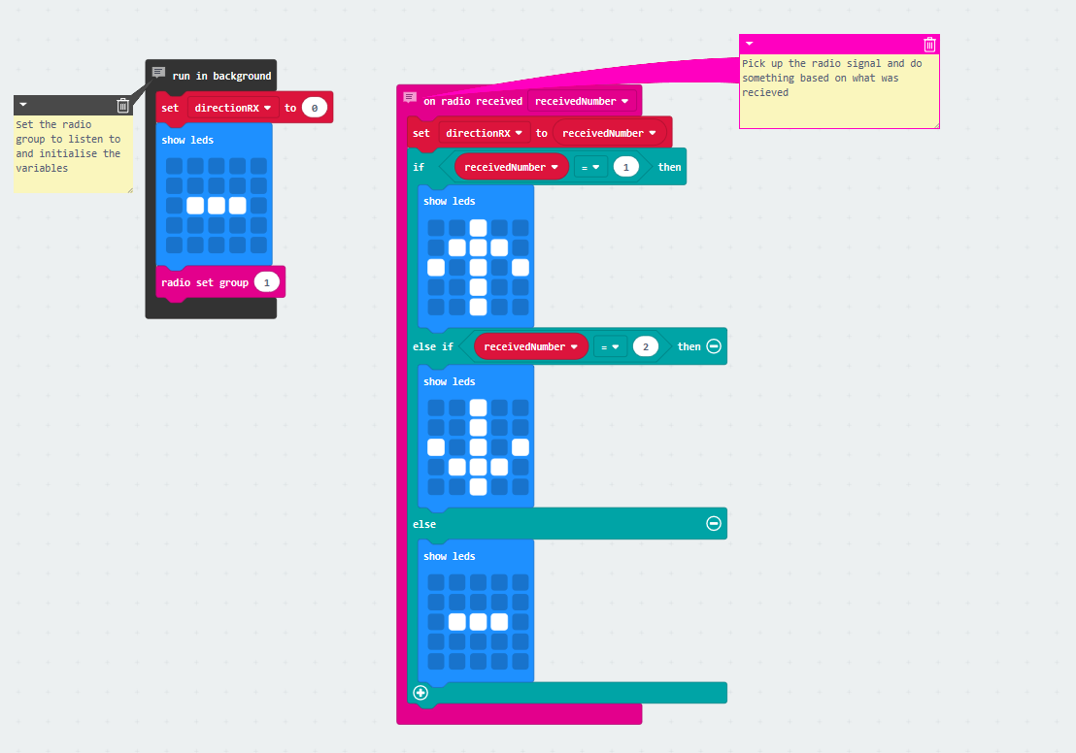
Receiver
For the receiving micro:bit copy the code or use the ‘Lesson 11 BTRX.hex’ file
Ensure the radio groups match
Flash the two micro:bits and test
Common problems:
Power levels too high or low
Different groups
The values being sent or received
Notes:
Explain to Learners that the receiver collects the data and processes it
Remind Learners of groups/channels
Point out how there are two process being run here. A background process that’s listening to a channel and a foreground process that will process any data that is heard
Go through the common problems, recommend that Learners start with a low power setting and if possible have make sure Learners with similar groups are not next to each other

Slide 7

Notes:
Large version for easier reading

Slide 8
Race Time - Heats
Time trial your car around the track
Try two cars – is the track big enough?

